Slide 1
Data Scientist Salaries
By: Krisha Bugajski

Slide 2
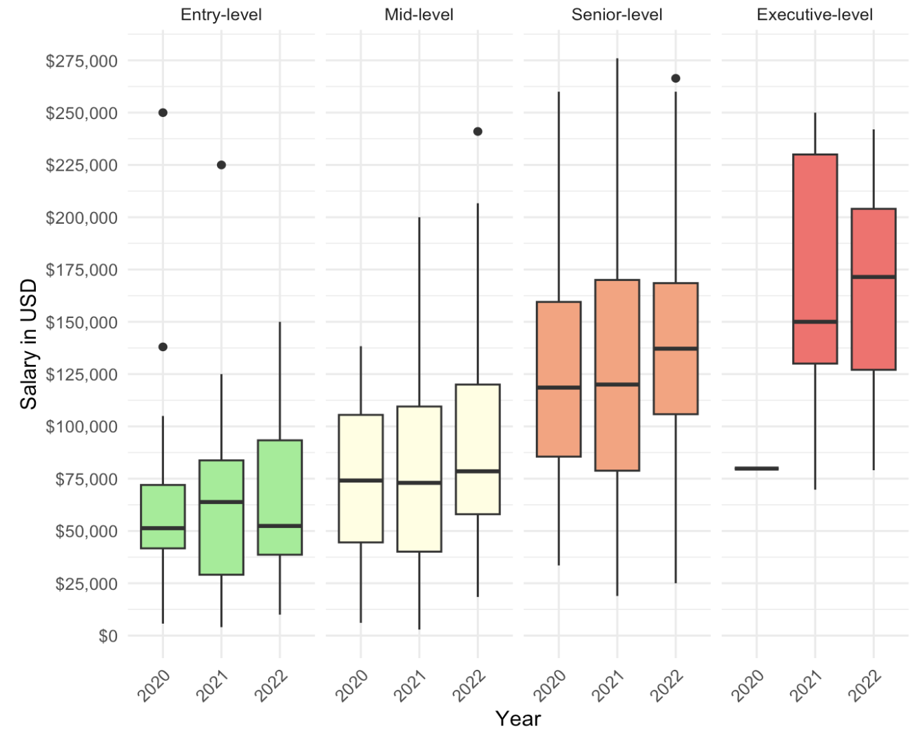
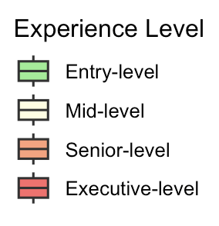
Salaries of Full Time Data Scientists
Notes:
As you many already know, Data Scientist salaries vary wildly around the world and year to year. I'm going to simplify a salary range that will be perfect for paying your new Data Scientist employee. I'll make a note that Before graphing this data, I disregarded some big outliers so we can start narrowing down that range.
Let's look at the graph. On the x-axis we have Years from 2020 to 2022, on the y-axis we have Salaries in USD of all full time Data Scientists, and the data is grouped and colored by experience levels, from Entry to Executive level. Sure enough, we can see that as the years increase within each experience level, the majority of the salaries also increase. I did some further research and found that the employment of data scientists is projected to grow 36% from 2021 to 2031 (Rutgers University, 2024). We must take this into account so we can have an accurate range for today's salaries. You can also see that as you move from an Entry-level position to the Executive-level position, the salaries increase.

Slide 3
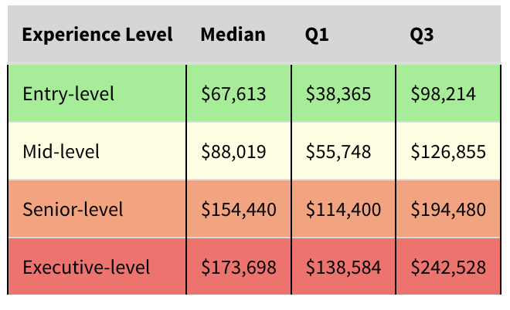
Estimated 2025 Full time Data Scientist Salaries
Notes:
Let's look more deeply and see what the projected 2025 full time Data Scientist salaries would be by looking at a table. This table shows the estimated 2025 salaries. The table contains the Median and the Interquartile range of the middle 50% of our data. It goes from Q1, the lower part of that range, and Q3, the upper part of that range. This way we can see the majority of our data and narrow down the range even further.
Since you currently have a small company and want your data scientist growing and learning the ways of your company as it continues to expand rapidly, you should look at hiring a data scientist that is at the Entry to Mid Level position. This way they will advance to the Senior or Executive level positions by the time your company becomes large, being able to lead new employees in the future. Also, to be competitive and to get top talent, it is important to look more toward the higher end of the salaries range, looking at the range from the median, up to Q3.
With this in mind and the projected 36% increase from 2021 to 2031, if you were to hire an Entry-level data scientist today, you are looking to pay them anywhere from $68,000 to $98,000. If you were to hire a Mid-level data scientist today, you are looking to pay them anywhere from $88,000 to $127,000.
Now, these salaries still account for all sized companies and companies not located in the US. So, let's take a closer look and compare the different company sizes and salaries for companies located in and out of the US.

Slide 4
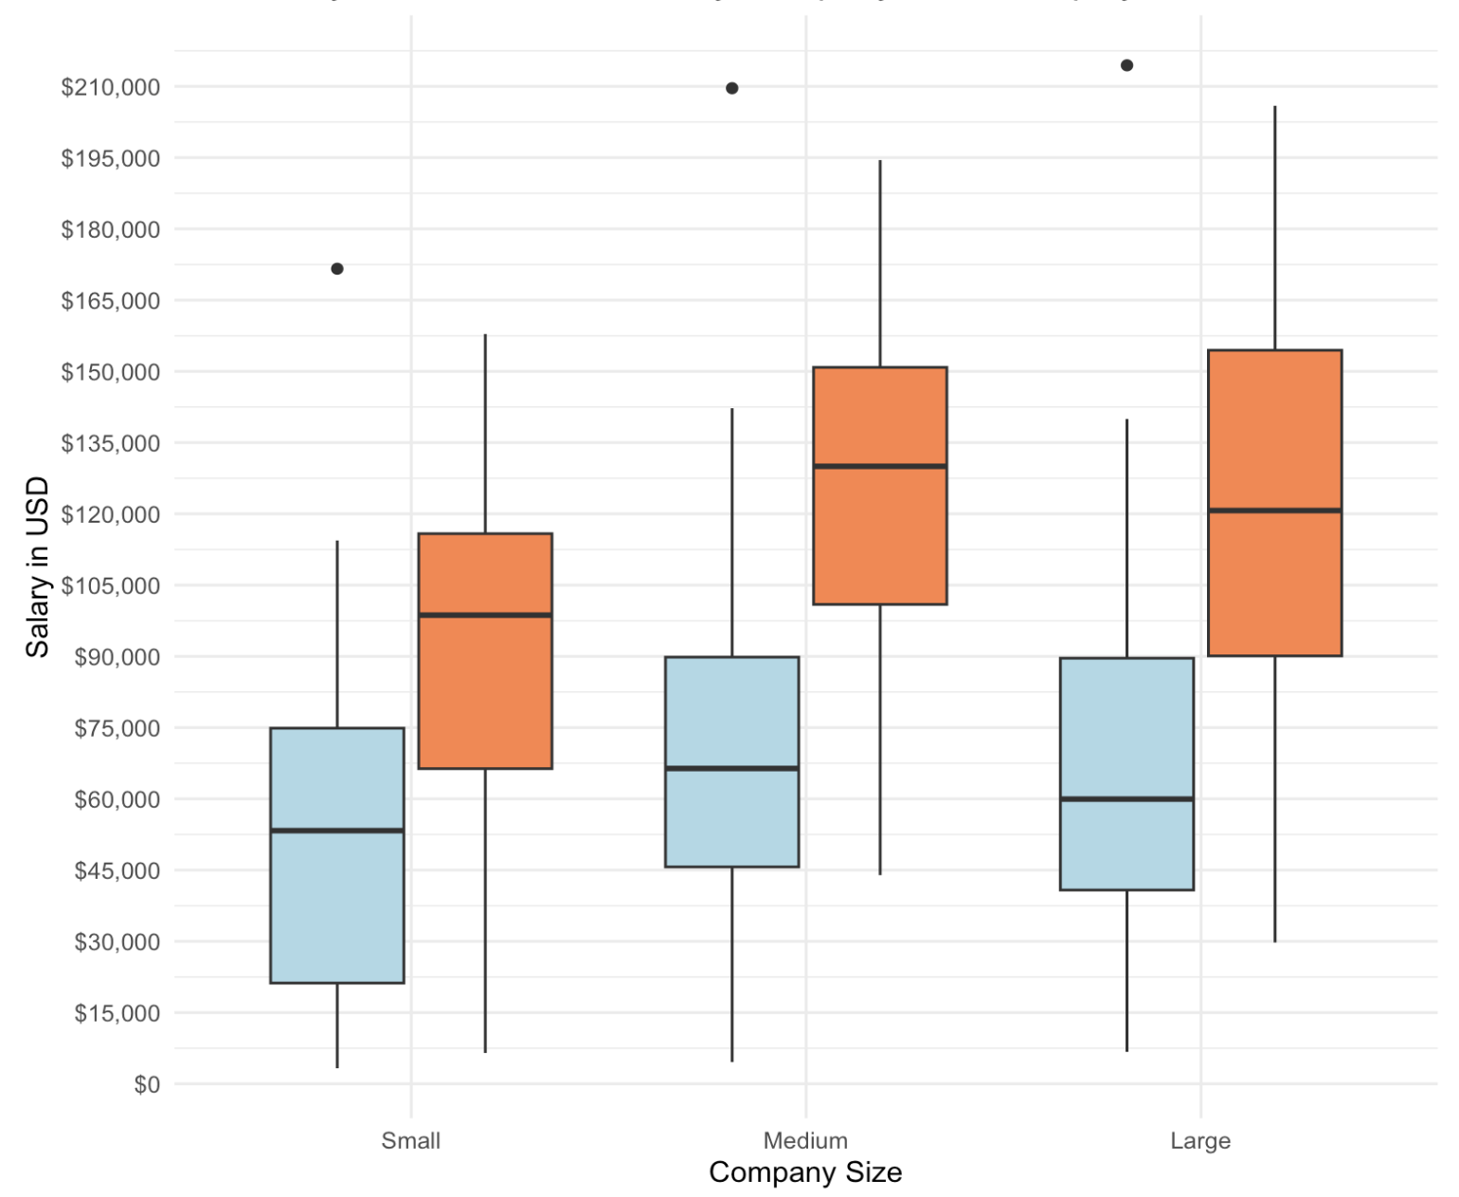
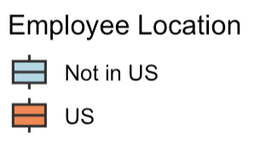
Estimated 2025 Entry and Mid Level Salaries
Notes:
When graphing the Entry and Mid level positions, I also disregarded some big outliers so we can get a narrowed down range. This graph shows the estimated 2025 salaries.
Let's start by looking at this graph. You will notice that I combined the Entry and Mid level positions. On the x-axis, we can see the company size, where Small represents less than 50 employees, Medium represents 50 to 250 employees, and Large represents more than 250 employees. The salaries in USD are on the y-axis and the graph is colored by the location of the employee, either in the US or not.
We can see that employees located in the US pay their Entry to Mid level employees a higher salary than those that are not located in US. We can also see that as the company grows from a small company to a large company, the salaries tend to increase from small to medium, and level out, slightly decreasing from medium to large. That makes sense when we think about it. Small companies aren't making as big as a profit so their employees salaries are lower, where medium sized companies have some more employees but are making a larger profit so they can pay their employees a slightly higher salary, and large companies have so many employees and their profits might not be enough to raise employee salaries, so they are paying their employees about the same or less than the medium sized companies.
Since your company is small at the moment, let's narrow down our range even more by looking closer at table of this data for smaller companies.

Slide 5
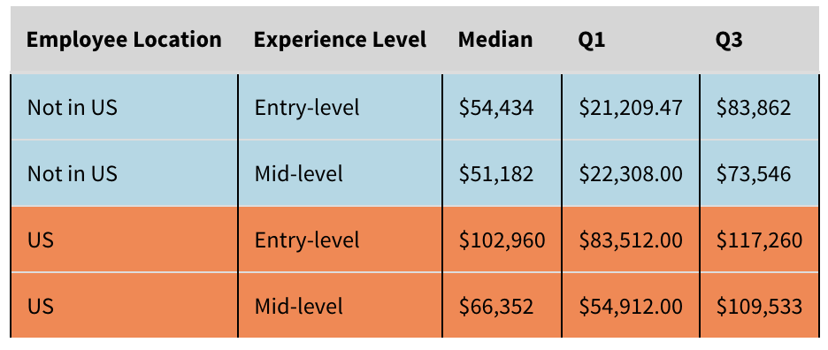
Estimated 2025 Small Company Data Scientist Salaries
Notes:
Now we are looking at estimated salaries for 2025 of Full time Data Scientists that are at Entry to Mid level positions, working at small companies, with the employees located in and out of the US. This table shows the Median and Interquartile range, from Q1 to Q3, similar to the previous table.
Let's look at the higher end of the salaries, from the Median to Q3 again to be competitive and to get top talent.
With the projected 36% increase from 2021 to 2031, if you were to hire a Entry to Mid level employee not located in the US today, you are looking to pay them anywhere from $51,000 to $84,000. If you were to hire a Entry to Mid level employee working in the US today, you are looking to pay them anywhere from $66,000 to $117,000.
#Conclusion:
So, I would recommend paying a data scientist anywhere from **$66,000 to $117,000**. This would get you a full-time data scientist that is at an Entry or Mid level position that can grow with your company and eventually become someone who can drive data science within the entire organization and could potentially lead a team in the future. This salary range is for a data scientist that is used to working for a small company and in the US. If you decide you don't mind your employee working outside of the US, you can pay them anywhere from **$51,000 to $84,000**. All these ranges account for the higher salary ranges due to the market being highly competitive. This higher salary range will also appeal to top talented data scientists.

Slide 6
Citations
Rutgers University. Data Science (M.S.). (n.d.). https://datascience.camden.rutgers.edu/careers-in-data-science/ (accessed, 2024)
Notes:
Here are my Citations. Any Questions?

